Slide 1
Presents
OO Programming with Java
Creating Classes
Notes:
Object-Oriented Programming with Java
Creating Classes
Module 5

Slide 2
Learning Objectives
We will now begin learning to create classes in Java.
We will learn how to:
  create classes
  assign attributes and methods to classes
  create static variables
  create Java packages

Slide 3
Introduction
Before we learn how to create Java classes, we need to know how to store our source code files into directories.
Since Java is platform neutral, it needs a platform neutral way to manage directories.
Java calls this “packages.”

Slide 4
The Java Directory System: Packages
All operating systems define some way to group files into directories.
Windows uses expressions like:
  C:\Program Files\IBM\SDP60\eclipse.exe
Linux uses:
  /home/jsmith/IBM/SDP60/eclipse
Java uses a period (.) to separate directories and calls these structures packages. For example:
  com.learnquest.utilityclasses

Slide 5
Packages Are Portable
Java programs are often moved from one OS to another.
  They must remain “detached” from the OS’s file system.
Java treats all packages as relative.
  A package system is not tied to the root of any file system.
When you move a Java system to a new machine, any root directory can be used to specify the location of the runtime classes.
  A “CLASSPATH” system environment variable points to the starting point(s) of the package structure.
  The JVM will resolve runtime class references within the package structure and the CLASSPATH.

Slide 6


Example: Moving Packages from Windows to Linux
A set of Java packages on Windows…
c:\
\My Programs
\Java
\Source
\com
\learnquest
\utility
\gui
\database
…is moved to linux.
/
/home
/jsmith
/java
/src
/com
/learnquest
/utility
/gui
/database
The Java packages start at the com directory.

Slide 7
Packages and the CLASSPATH
Java needs some way of finding the packages it will use.
  This information is provided to Java via the CLASSPATH variable.
CLASSPATH can be:
  Set up as a system-wide environment variable
  Passed to the Java program when your program starts

Slide 8
Packages and the CLASSPATH
Here’s an example of setting the classpath at runtime:
  java.exe –classpath C:\JavaCode\Project1 com.learnquest.guiclasses.MyProgram
This command will attempt to run the main() method of the MyProgram class.
When this command is issued, java.exe runs and then looks for MyProgram in the directory:
C:\JavaCode\Project1\com\learnquest\guiclasses
Notes:
Study this carefully – it’s important and can save you a lot of confusion later.
Notice how java.exe combines the system specific CLASSPATH variable with the system-neutral, Java-specific packaging.
This is a key feature of Java’s portability.

Slide 9
Classes and Files
In general, each Java class is stored in its own file.
  Source file format is “class name”.java
  Compiled source files will have the SAME name as the .java file it was compiled from but with an extension of .class, i.e., “class name”.class.
  For example:
    The source code in Account.java is compiled and stored in Account.class
Notes:
When the class is compiled, the compiler (a program called javac) produces a file with the same name as the source code file but with an extension of .class instead of .java. It is the class files that must be in the classpath at runtime.

Slide 10
Declaring a Class
Here are the components of a class declaration shown in the order they should appear:
<public> <abstract> <final> class className
<extends superclassName>
<implements interfaceName>
{
//class body
}
The angle brackets indicate optional components.
Most classes will be created as public.
Notes:
public - Declares that class is publicly accessible
abstract - Declares that class cannot be instantiated; this optional attribute is discussed more thoroughly in a later chapter
final - Declares that class cannot be subclassed; the notion of subclassing is covered in the chapter on inheritance
class - Indicates to the compiler that this is a class declaration
className - Valid identifier used to specify the name of the class

Slide 11
A Very Simple Class
Here is the outline of a Car class with no attributes or methods.
This class definition would be defined in a file named Car.java.
public class Car {
}

Slide 12
Putting a Class in a Package
Classes should always be placed in a package.
  This is not mandatory, but is HIGHLY encouraged.
  Packages allow you to organize the classes that make up an application.
The first line of the .java file should be the package declaration.
The Car class is being placed in a package named com.lq in the example below:
package com.lq;
public class Car {
}
Notes:
Note that the file Car.java must be in the corresponding package directory in the file system. By convention, package names use a reverse internet domain naming scheme.

Slide 13
Anatomy of a Class
Now let’s look at adding attributes and methods to our classes. The general form is:
public class classname {
type attribute1;
// …
type attributeN;
type methodname1(parameter-list)
{ // body of method }
// …
type methodnameN(parameter-list)
{ // body of method }
}
Notes:
Two primary components make up the implementation of a class:
1) The class declaration
2) The class body
The class body follows the class declaration and is embedded within curly braces "{" and "}".
The class body contains declarations for all instance variables and class variables (known collectively as member variables) for the class.
In addition, the class body contains declarations and implementations for all instance methods and class methods (known collectively as methods) for the class.

Slide 14
Anatomy of a Class – Some Notes
Carefully examine the use of braces {} in the previous slide.
Notice that:
  There is an opening and a closing brace for the entire class. This is called the “class block.”
  There is an opening and a closing brace for each method – the “method block.” (This is where the code for that method will be placed).
  The attributes are defined inside the class block but outside all of the method blocks
These blocks can get confusing! Java programs use indentation to make reading the source code easier.

Slide 15
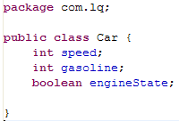
Adding Attributes to a Class
Attributes must be added inside the class block and outside all method blocks.
They must be given a data type. In this example we’ll use the simple types int and boolean. Here is Car with some attributes added:

Slide 16
The Methods of a Class
Methods provide the behavior of the class.
Methods and attributes have accessibility, meaning that there are restrictions on who may invoke a method or access an attribute.
The two most common accessibilities are:
  public – allows access by all other objects in the system
  private – allows access only within the same class definition

Slide 17
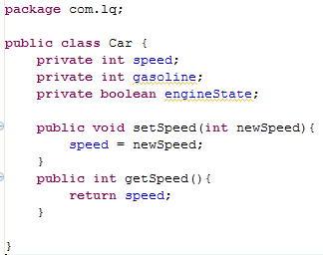
Adding Methods and Visibility
  Methods must be defined with their name, signature and return type.
  If a method returns nothing it must be declared to return void.
  This example has set the accessibility of the methods to public and the attributes to private.
Notes:
Public methods mean that any object in the Java system may invoke them on a Car object. By setting the attributes to private, we are forcing users of the Car class to call the business methods (setSpeed and getSpeed) vs. modifying the attributes directly. This allows us to control access to the data and is the groundwork for a key OO concept called Encapsulation.

Slide 18
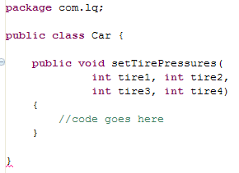
Method Parameters
Method parameters allow data to be passed into a method.
Multiple method parameters are separated by a comma.
Notes:
When an object calls a method it needs to provide values for each variable in the method signature.
For example, to call the setTirePressures method of Car we would call:
myCar.setTirePressures(32, 32, 41, 41);
This assumes that we have already created an object of type Car named myCar.

Slide 19
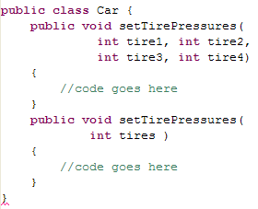
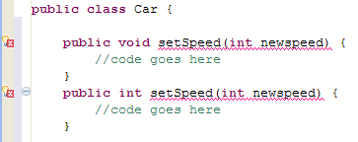
Method Parameters
Java will accept methods with the same name as long as they have different signatures.
Return values are not considered when determining the uniqueness of method signatures
The methods shown above are okay, the ones below are not.

Slide 20
Variable Argument Methods
Gives us additional flexibility by allowing us to define methods that accept a varied number of arguments.
The arguments must all be of the same type.
To specify a variable number of ints for example:
public void myExampleMethod(int … v){}
The three dots (an ellipsis) indicate that the method accepts a variable number of parameters.
This is known as varargs

Slide 21
Method Variables
Methods can create variables for their exclusive use.
  These variables can only be seen by the code in the method block.
These “method variables” are defined inside the method block.
  Variables may be defined anywhere in the block.
  Variables are only available to code below where they are defined.
  Usually declared at the very top of the method block.

Slide 22
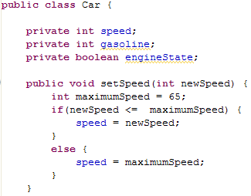
Method Variable Example
The variable, maximumSpeed is available only to the code in the setSpeed() method.

Slide 23
More on Accessibility
In Java, attributes and methods are assigned an accessibility.
Accessibility determines whether other Java objects can access that attribute or method.
Java provides four levels of accessibility :
  private - Accessible only to the class in which it is defined
  default – aka package. default allows access to classes in the same package but does not allow access to sub-classes unless they are in the same package. (default is indicated by the absence of a modifier)
  protected - Accessible in the class itself, subclasses and all classes in the same package
  public - Accessible to any class, in any package
Notes:
We will talk more about sub-classes and inheritance in another unit.

Slide 24
Constructors
A constructor is a special type of method that Java uses to create instances of a class.
  The constructor has no return value not even void.
  Must have the same name as the class it initializes
A new operation constructor call returns an reference to the newly create object that the constructor initializes.
You may not be required to provide a constructor for your classes.
  If you do not supply a constructor, Java will automatically initialize all the attributes to preset values (low values).

Slide 25
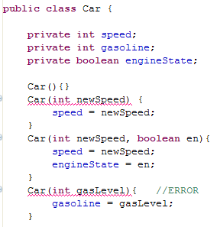
Creating Your Own Constructors
  A class can have more than one constructor. Since the constructors all have the same name as the class we can only distinguish constructors by their signatures.
  Therefore, you can’t have two constructors with the same signature.
Notes:
Notice that signatures are identified by their data types and by the order in which they are listed in the signature – not by their names.
If you allow Java to automatically provide the default constructor and you later write a constructor that takes a parameter, you will lose the default constructor.
As a result, code like this:
Car vw = new Car()
which worked fine before, would suddenly produce a compiler error. The solution: best practice dictates that you always write the default constructor.

Slide 26
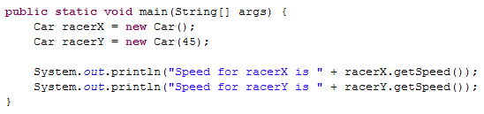
Constructors
A constructor is called when the new operator is used to create an object.
Our class Car can create some Car objects and references in its main() method.
The output of executing this code would be:
      Speed for racerX is 0
      Speed for racerY is 45
Notes:
The constructor that takes one integer uses that value to set the speed of the car. Notice that the no argument constructor sets the speed to the default value of zero.

Slide 27
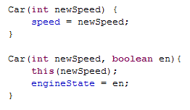
Multiple Constructors
It is possible for one constructor to call another constructor in the same class using the this() statement.
This reduces the potential for code to be duplicated between constructors.

Slide 28
Static Attributes
Attributes, including method attributes, can be set up so that they have only one value across all instances inside the same system. These variables are created with the keyword static:
static int maxSpeed = 65;
If one Car object changes the value of maxSpeed, all other Car objects will see the new value.
This essentially creates a variable that can be shared by all objects of the same type.
Notes:
Static values are shared only across instances running inside the same Java Virtual Machine.

Slide 29
Declaring Constants
Declaring an attribute to be final means that its value cannot be changed once assigned a value.
public final int MAX_SPEED = 65;
Many modifiers can be combined.
As a class, determine what the following combination of modifiers implies:
protected final static int MY_AGE = 29;
Notes:
There are two other declaration modifiers: transient and volatile. These two modifiers are beyond the scope of this class and we include them here for completeness only.
Transient marks variables that should not be serialized.
Volatile is used to prevent the compiler from performing certain optimizations on a data member .i.e., when its value is modified outside of the program such as a hardware register on a machine.

Slide 30
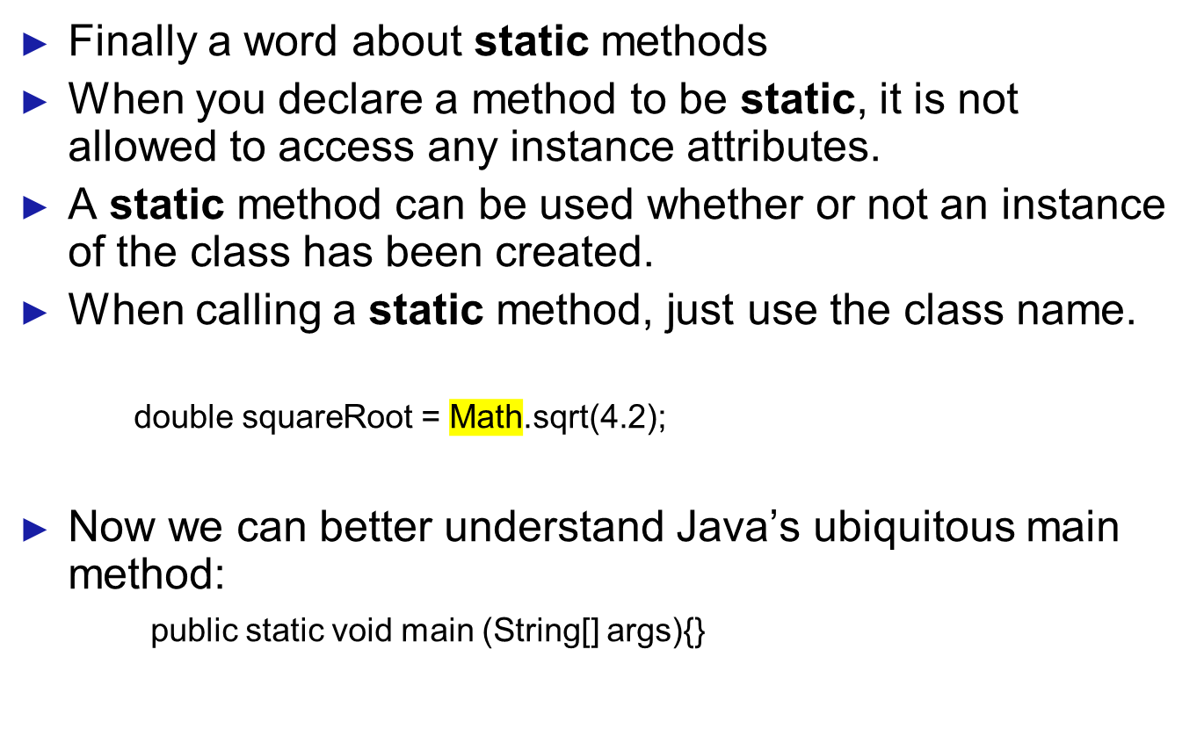
Static Methods
Notes:
Take a moment to think about why a static method is not allowed to access instance attributes. Look at the second bullet in the slide above. How would a static method know which instance to access? A static method does not have access to the this operator. As such, it does not have access to the instance.
And why must main be static? When a Java program starts up, NO objects have been created, so no non-static methods are available. We have to have a static method to “get going” and then – from that method – we can start creating objects.

Slide 31
Two Important Sets of Static Methods
The Java class System is always used statically.
Since the JRE is always running within a single operating system, there will never be more than one “instance” of that system.
System provides a number of important “hooks” to the OS: the most common being:
  System.out.println();
Java contains a class called Math in which all of the methods are static. You never need to instantiate a Math object. Instead you just use the methods with the class name itself:
  Math.sin(4.2);
Notes:
This is a major contributor to platform independence since it hides the details of the OS from the programmer

Slide 32
Summary
In this chapter we learned:
How to construct classes
What packages are and how to use them in Java
What accessibility is and how Java applies it to attributes and methods
How to work with Java’s constructors

